Slide 1

Advanced Systems Lab - 2nd Meeting
Anastasija Tortevska, Glenn Schönbächler,
Kristijan Zafirovski, Mukhammadali Sayfiddinov
TexPoint fonts used in EMF.
Read the TexPoint manual before you delete this box.: AAAAA

Slide 2
General Remarks
Work distribution unchanged from previous week
We aimed to optimize everything up to SIMD vectorization for the respective functions
We split into v0 to v3:
v0: unoptimized dense baseline
v1: math optimization
exploit sparsity
v2: pre-SIMD rewrite
eliminate redundant work and memory traffic
v3: explicit SIMD vectorization (in progress)

Slide 3
Anastasija Tortevska
equi_geometric_attention

Slide 4
v1 — Math optimization
DAA attention feature map is only 5-dimensional and has a closed-form expression
Skip the generic basis-built einsum; emit the 5 outputs directly from the 4 trivector coordinates
Replace tensor setup + contraction with a handful of scalar multiplies/adds
Query side becomes [sum012, x3^2, x0x3, x1x3, x2x3]
Key side becomes [-x3^2, -sum012, 2x0x3, 2x1x3, 2x2x3]

Slide 5
v2 — Structural Rewrite
Supported attention kinds are few and fixed, so specialize the path instead of running a generic per-kind assembly pipeline
Skip repeated tensor bookkeeping and generic dispatch; route directly to the needed IPA / DAA feature builders
Fuse query/key feature construction into one dedicated multivector fast path with fewer intermediate tensors
Keep the closed-form DAA computation from ver_1, but assemble the final attention features in a tighter pre-SIMD kernel

Slide 6
Glenn Schönbächler
Description

Slide 7
Kristijan Zafirovski
equi_linear

Slide 8
v0 → v1: Exploiting Sparsity
The problem with v0
Does python einsum, builds a full 16×16 weight matrix M per (o, i) pair, then runs a dense matrix-vector multiply
256 multiply-accumulates per (b, o, i) iteration, most multiplying by zero
The fix in v1
The equivariant basis has only 24 nonzero couplings out of 256 possible
Skip the matrix entirely, hand-unroll just the 24 nonzero terms directly
16 diagonal (grade-preserving) + 8 off-diagonal (e₀-related)
Notes:
Layer 1: Eliminate Redundant Work

Slide 9
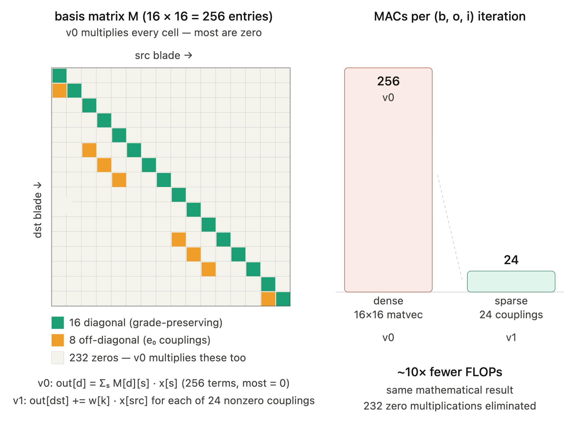
v0 → v1: Exploiting Sparsity

Slide 10
v2.1 — Eliminate Redundant Work
Hoist Normalization
w[k] × inv_norm[k] depends only on (o, i), never on batch item b
v1 recomputes it inside all 3 loops: B × O × I × 9 multiplications
v2 precomputes once before the batch loop: O × I × 9 multiplications
Saving scales exactly with batch size
Fold Bias In
compute full output, then add bias in a separate post-kernel pass
That pass costs B × O read-modify-writes after the kernel finishes
v2 initialises acc[0] = bias[o] before the i loop — bias is baked in for free
Skip Zero-Init
torch::zeros writes the entire output buffer to zero before the kernel starts
Every output element is fully overwritten by the acc[] store anyway
torch::empty skips the pre-pass entirely
Notes:
Layer 1: Eliminate Redundant Work

Slide 11
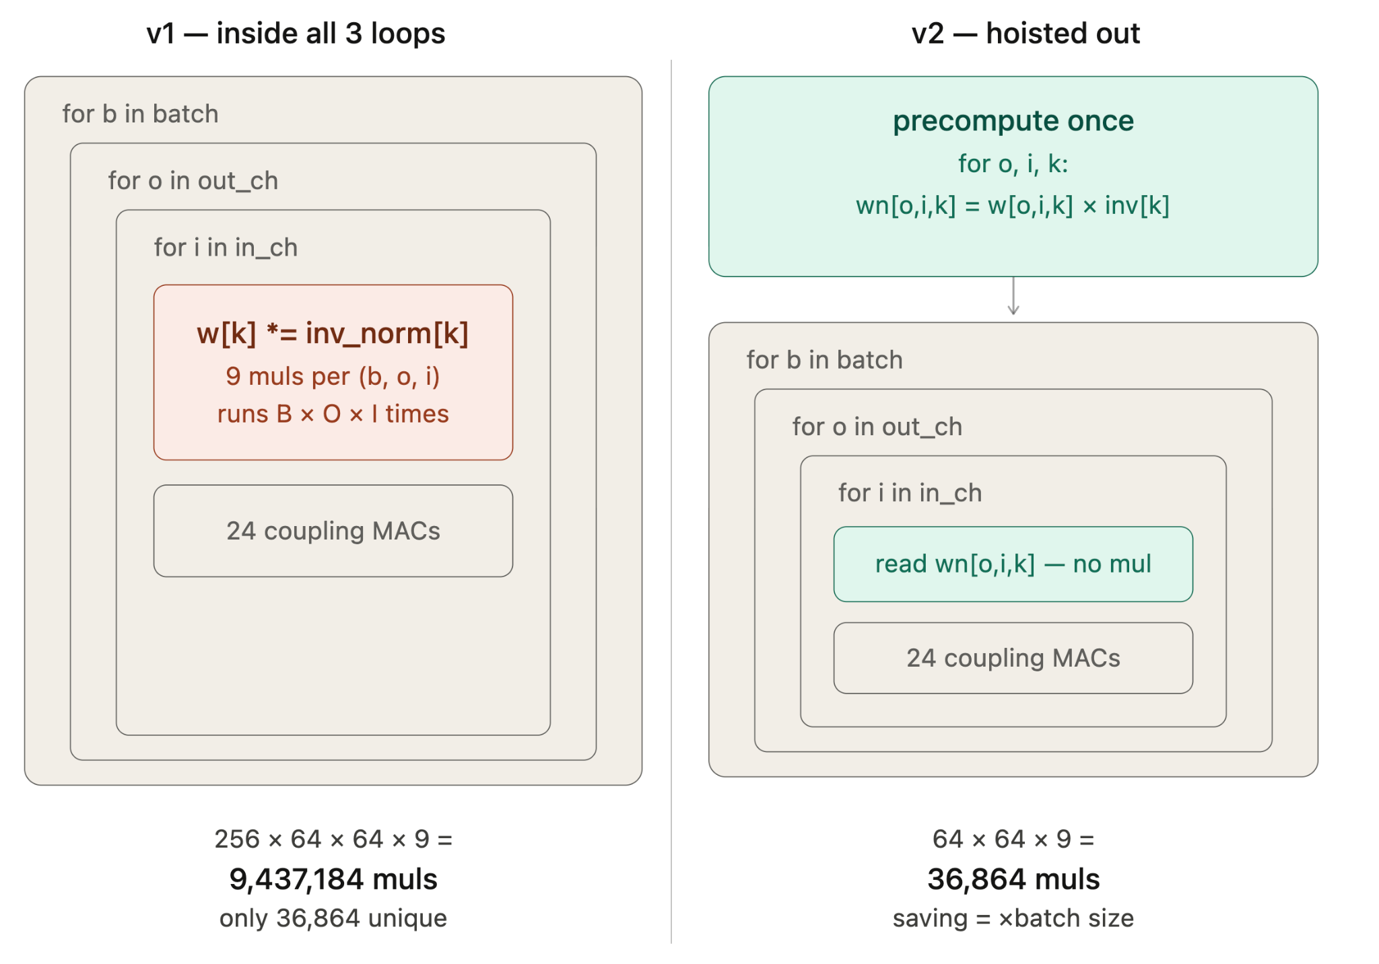
v2.1 — Eliminate Redundant Work

Slide 12
v2.2 — Reduce Memory Traffic
Register-Resident Accumulator
v1: every += is a read-modify-write to memory, 64 iters × 24 couplings = 1,536 writes to the same 16 addresses per (b, o)
v2: T acc[16] lives in CPU registers, then accumulate across all input channels, store once. 16 writes total
96× fewer memory writes per (b, o) pair
Thread-Local Weight Buffer
Naïve: allocate a fresh std::vector on every call, model calls equi_linear dozens of times per forward pass
static thread_local vector: capacity persists across calls, zero heap allocation at steady state, one buffer per thread so no mutex needed

Slide 13
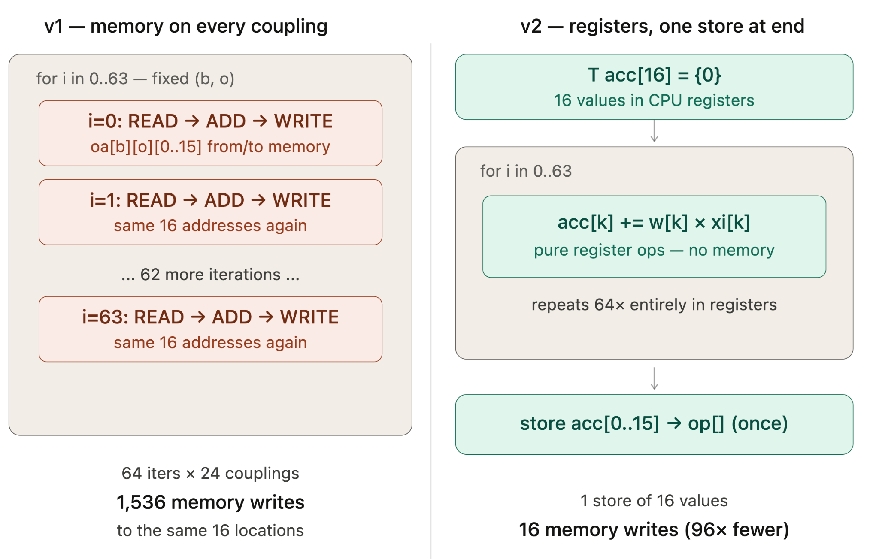
v2.2 — Output in registers, written once

Slide 14
v2.3 — Improve Instruction Quality
__restrict__ Raw Pointers
TensorAccessor hides the pointer in a struct, compiler assumes aliasing, re-fetches values from memory after every write
data_ptr<T>() + __restrict__ proves xp, op, wn never overlap, reload barriers disappear, values stay in registers
Grade-Block Loops
Diagonal couplings regrouped into 5 short fixed-trip loops by grade shaped to hint the compiler toward autovectorization
Not yet verified need to inspect assembly and benchmark v2 vs v1
v3: replace with explicit AVX2 intrinsics to guarantee SIMD

Slide 15
Mukhammadali Sayfiddinov
Description

Slide 16
Next Steps and Project Deadline planning
Final Benchmarking runs
Implement v3: explicit AVX2 intrinsics
Profile full model forward pass and identify remaining bottlenecks
Prepare final presentation with timing results cost analysis and roofline plots

Slide 17
General Questions

